Slide 1




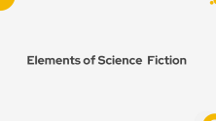









Introduction
Author
Characters
Summary
Elements
Themes

Slide 2

WELCOME

Slide 3
WELCOME

Slide 4
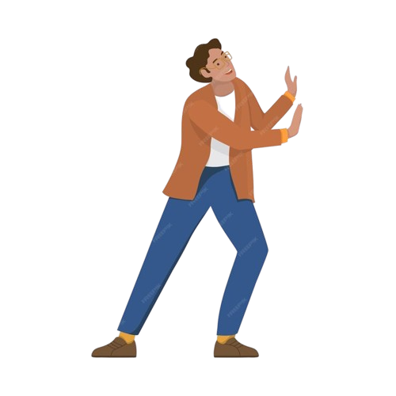
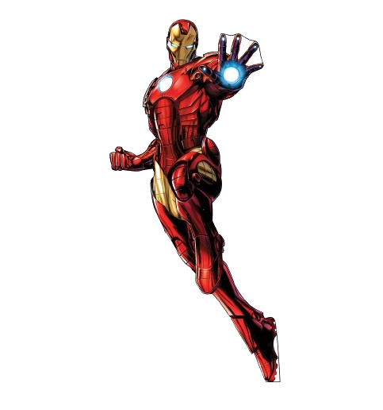
THE METAL MAN JACK WILLIAMSON
Presented By:
James Karki
Nikesh Gajurel
Bikram Gyawali
Nikesh Gajurel

Slide 5
THE METAL MAN JACK WILLIAMSON
Presented By:
James Karki
Nikesh Gajurel
Bikram Gyawali
Notes:
Good afternoon everyone.
Welcome to the presentation
First of all we would like t o express our gratitude to our respected teacher HK Lamichane sir for providing with this wonderful opportunity.
Today we have Nikesh Gajurel, Bikram gyawali, and myself James Karki as your presenters.

Slide 6
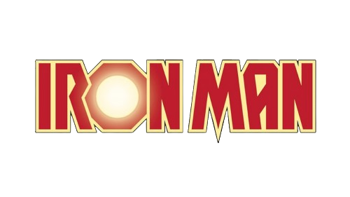
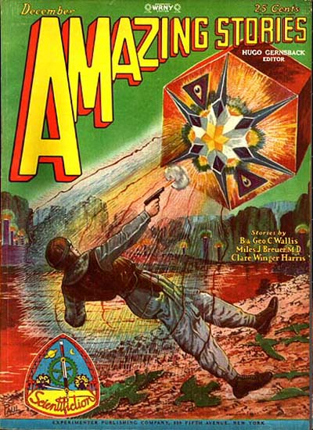
THE METAL MAN JACK WILLIAMSON
THE METAL MAN JACK WILLIAMSON
Presented By:
James Karki
Nikesh Gajurel
Bikram Gyawali

Slide 7
THE METAL MAN JACK WILLIAMSON
Amazing Stories is an American science fiction magazine launched in April 1926 by Hugo Gernsback's Experimenter Publishing.

Slide 8
THE METAL MAN JACK WILLIAMSON
Amazing Stories is an American science fiction magazine launched in April 1926 by Hugo Gernsback's Experimenter Publishing.
Notes:
Amazing Stories is an American science fiction magazine launched in April 1926 by Hugo Greenback's Experimenter Publishing. It was the first magazine devoted solely to science fiction.

Slide 9
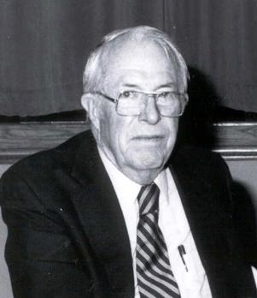
AUTHOR
Jack Williamson

Slide 10
AUTHOR
About author
Name: John Stewart Williamson
Born: 29 April 1908
Died: 10 November,2006
Occupation: Writer, professor of English
Genre: Science fiction
Jack Williamson

Slide 11
About author
Name: John Stewart Williamson
Born: 29 April 1908
Died: 10 November,2006
Occupation: Writer, professor of English
Genre: Science fiction
Notes:
John Stewart Williamson who wrote as Jack Williamson born April 29, 1908, in Bisbee, Arizona Territory. , was an American science fiction writer, one of several called the "Dean of Science Fiction". As a child Williamson enjoyed storytelling to his brother and two sisters. As a young man, he discovered the magazine Amazing Stories, established in 1926 by Hugo Gernsback, through which he published his first science fiction story "The Metal Man" in 1928 AD. During the next year Hugo published three more of his stories in the new pulp magazines Science Wonder Stories and Air Wonder Stories, and separately published "The Girl from Mars" by Miles J. B and Williamson as Science Fiction Series. Regarding his academic career, Jack earned both his Bachelor of Arts and Master of Arts degrees in English from Eastern New Mexico University in the 1950s. He went on to become an English professor at the same university, where he taught for many years.. Over the years he wrote 52 novels and over 100 shorter stories. Some of his writings include:

Slide 12
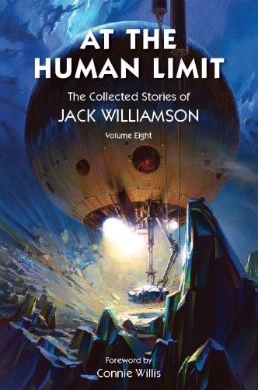
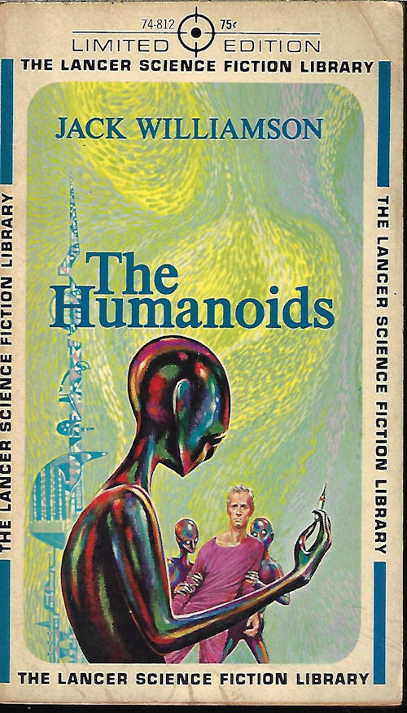
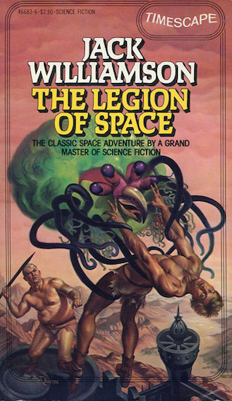
About author
Jack Williamson
Writings
Name: John Stewart Williamson
Born: 29 April 1908
Died: 10 November,2006
Occupation: Writer, professor of English
Genre: Science fiction
Notes:
At the Human Limit ,Originally published in 2011.

Slide 13
Jack Williamson
Writings
Notes:
1949 Dystopian science fiction Novel ‘The Humanoids ’

Slide 14
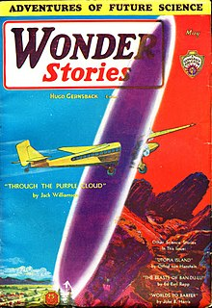
Jack Williamson
Writings
Notes:
The legion space Originally published in 1947.

Slide 15
Jack Williamson
Writings
Notes:
Through the purple cloud , published in 1931 and more like these .

Slide 16
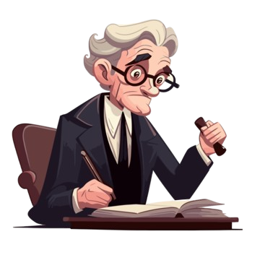
CHARACTERS
01
Professor Thomas Kelvin
The protagonist and narrator of the story.
An adventurous scientist who is on a quest to discover radium deposits
Notes:
Now that we’ve covered the introduction and author’s background, it is time to discuss about the characters of the story.
The first character is

Slide 17
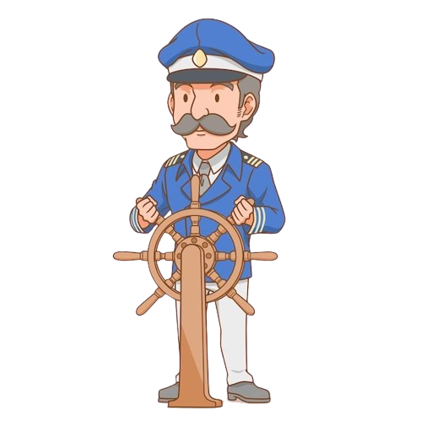
CHARACTERS
Professor Thomas Kelvin
Captain McAndrews
The protagonist and narrator of the story.
An adventurous scientist who is on a quest to discover radium deposits
A trusted ally of Professor Kelvin.
Kelvin expresses trust in him and relies on his help, particularly regarding his travels and safety.
01
Notes:
1.Professor Thomas Kelvin: is the protagonist and narrator of Jack Williamson's "The Metal Man." He is shown as an adventurous scientist driven by curiosity and a relentless pursuit of discovery. His primary goal is to find radium deposits in the remote regions of South America, which highlights both his scientific ambitions and his willingness to face significant risks.

Slide 18
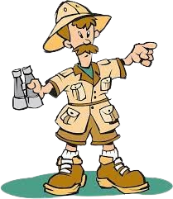
CHARACTERS
Captain McAndrews
Indian Guide
Professor Thomas Kelvin
A trusted ally of Professor Kelvin.
Kelvin expresses trust in him and relies on his help, particularly regarding his travels and safety.
Kelvin’s guide during part of his expedition
He assists Kelvin in navigating the challenging terrain
The protagonist and narrator of the story.
An adventurous scientist who is on a quest to discover radium deposits
02
Notes:
Captain Mac Andrews : A trusted ally of Professor Kelvin.
Here, the word ally means someone who help and support you, especially when other people are not.
Kelvin expresses trust in him and relies on his help, particularly regarding his travels and safety.

Slide 19
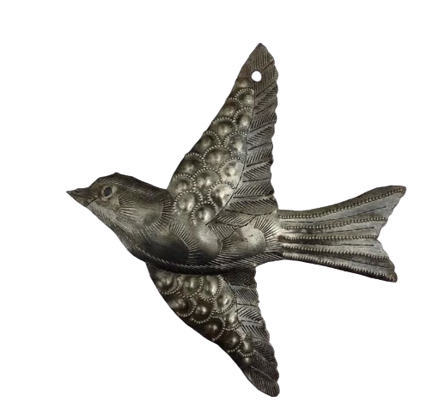
CHARACTERS
Captain McAndrews
Indian Guide
Metal Birds and Pterosaur
A trusted ally of Professor Kelvin.
Kelvin expresses trust in him and relies on his help, particularly regarding his travels and safety.
Kelvin’s guide during part of his expedition
He assists Kelvin in navigating the challenging terrain
These are transformed into metal by the radioactive conditions, representing the impact of the environment on organic life.
03
Indian Guide
Kelvin’s guide during part of his expedition
He assists Kelvin in navigating the challenging terrain
Notes:
Indian Guide:
Kelvin’s guide during part of his expedition.
He assists Kelvin in navigating the challenging terrain but does not play a major role in the narrative beyond helping with initial exploration.

Slide 20
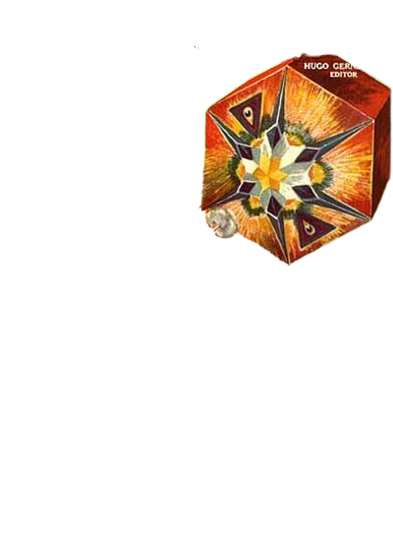
CHARACTERS
The Crystal Entity
Metal Birds and Pterosaur
Indian Guide
These are transformed into metal by the radioactive conditions, representing the impact of the environment on organic life.
A crystalline, multi-faceted entity that exhibits strange intelligence and control over gravity.
Kelvin’s guide during part of his expedition
He assists Kelvin in navigating the challenging terrain
04
Notes:
Metal Bird and Pterosaur:
Evidence of the strange effects of the alien environment.
These are transformed into metal by the radioactive conditions, representing the impact of the environment on organic life.

Slide 21
CHARACTERS
Metal Birds and Pterosaur
The Crystal Entity
These are transformed into metal by the radioactive conditions, representing the impact of the environment on organic life.
A crystalline, multi-faceted entity that exhibits strange intelligence and control over gravity.
05
Notes:
The Crystal Entity:
An alien life form that captures Kelvin.
A crystalline, multi-faceted entity that exhibits strange intelligence and control over gravity. It represents the advanced and incomprehensible nature of the alien beings in the story.
Now, I would like to call James Karki in order to summarize the story “The Metal Man “ .

Slide 22

SUMMARY

Slide 23
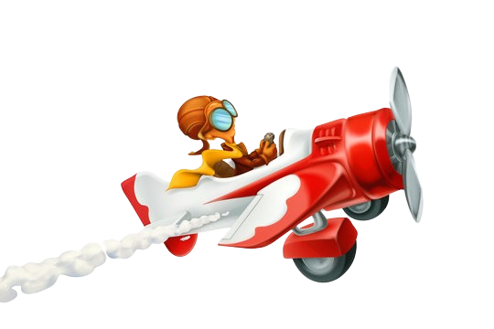
SUMMARY
"The Metal Man" by Jack Williamson begins with a metal man standing in a dark, dusty corner of the Tyburn College Museum. The story continues with a manuscript written by Thomas Kelvin, a geology professor, who describes his thrilling adventure in search of radium. Initially, Kelvin tried to hire an Indian guide to help him reach his goal, but due to radium exposure, the guide was unable to assist. Eventually, Kelvin bought a monoplane and set off for his destination.
Unfortunately, Kelvin crashes into a mysterious crater filled with strange phenomena. After the crash, as he explores the unusual landscape, Kelvin encounters a thick, green mist that makes gravity much stronger. He also finds a forest of metallic plants and alien crystal-like creatures. He notices that birds and other animals have turned to metal due to the crater's strange powers, and he becomes worried when he sees his own body beginning to transform into metal.
Desperate to find a solution, Kelvin discovers a patch of violet plants with berries that can stop the metal transformation. He also comes across a slow, red river called El Rio de la Sangre ("The River of Blood") flowing through the crater, which adds to the eerie and desolate atmosphere with its reddish color. While trying to avoid the crystal beings, Kelvin finds a group of black towers that shoot out strange flames affecting gravity.
Using quick thinking, he fires his gun to propel himself out of the strong gravity field and returns to his airplane. After escaping the crater and getting back to civilization, Kelvin writes a letter about his experiences and mentions the discovery of valuable radium-rich sand.
However, the story ends on a tragic note, as Kelvin continues to suffer from the metal transformation despite his efforts to stop it.
Notes:
How the story starts with manuscript
About captain mcandrews
Hiring Indian guide, and buying monoplane

Slide 24
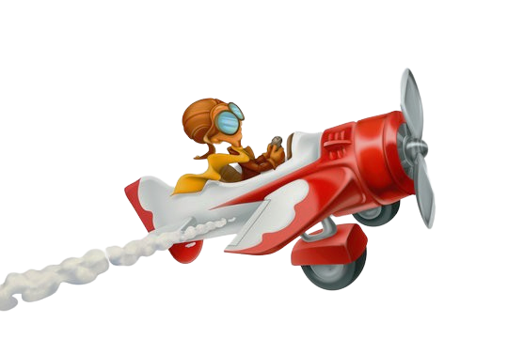
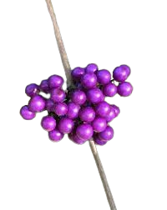
"The Metal Man" by Jack Williamson begins with a metal man standing in a dark, dusty corner of the Tyburn College Museum. The story continues with a manuscript written by Thomas Kelvin, a geology professor, who describes his thrilling adventure in search of radium. Initially, Kelvin tried to hire an Indian guide to help him reach his goal, but due to radium exposure, the guide was unable to assist. Eventually, Kelvin bought a monoplane and set off for his destination.
Unfortunately, Kelvin crashes into a mysterious crater filled with strange phenomena. After the crash, as he explores the unusual landscape, Kelvin encounters a thick, green mist that makes gravity much stronger. He also finds a forest of metallic plants and alien crystal-like creatures. He notices that birds and other animals have turned to metal due to the crater's strange powers, and he becomes worried when he sees his own body beginning to transform into metal.
Desperate to find a solution, Kelvin discovers a patch of violet plants with berries that can stop the metal transformation. He also comes across a slow, red river called El Rio de la Sangre ("The River of Blood") flowing through the crater, which adds to the eerie and desolate atmosphere with its reddish color. While trying to avoid the crystal beings, Kelvin finds a group of black towers that shoot out strange flames affecting gravity.
Using quick thinking, he fires his gun to propel himself out of the strong gravity field and returns to his airplane. After escaping the crater and getting back to civilization, Kelvin writes a letter about his experiences and mentions the discovery of valuable radium-rich sand.
However, the story ends on a tragic note, as Kelvin continues to suffer from the metal transformation despite his efforts to stop it.

Slide 25
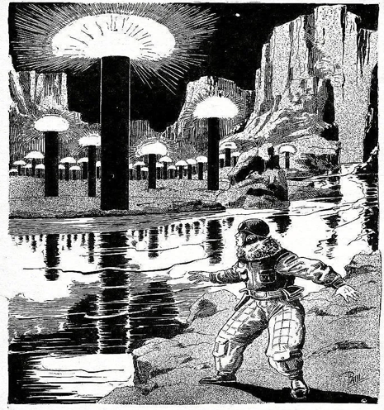
"The Metal Man" by Jack Williamson begins with a metal man standing in a dark, dusty corner of the Tyburn College Museum. The story continues with a manuscript written by Thomas Kelvin, a geology professor, who describes his thrilling adventure in search of radium. Initially, Kelvin tried to hire an Indian guide to help him reach his goal, but due to radium exposure, the guide was unable to assist. Eventually, Kelvin bought a monoplane and set off for his destination.
Unfortunately, Kelvin crashes into a mysterious crater filled with strange phenomena. After the crash, as he explores the unusual landscape, Kelvin encounters a thick, green mist that makes gravity much stronger. He also finds a forest of metallic plants and alien crystal-like creatures. He notices that birds and other animals have turned to metal due to the crater's strange powers, and he becomes worried when he sees his own body beginning to transform into metal.
Desperate to find a solution, Kelvin discovers a patch of violet plants with berries that can stop the metal transformation. He also comes across a slow, red river called El Rio de la Sangre ("The River of Blood") flowing through the crater, which adds to the eerie and desolate atmosphere with its reddish color. While trying to avoid the crystal beings, Kelvin finds a group of black towers that shoot out strange flames affecting gravity.
Using quick thinking, he fires his gun to propel himself out of the strong gravity field and returns to his airplane. After escaping the crater and getting back to civilization, Kelvin writes a letter about his experiences and mentions the discovery of valuable radium-rich sand.
However, the story ends on a tragic note, as Kelvin continues to suffer from the metal transformation despite his efforts to stop it.

Slide 26
"The Metal Man" by Jack Williamson begins with a metal man standing in a dark, dusty corner of the Tyburn College Museum. The story continues with a manuscript written by Thomas Kelvin, a geology professor, who describes his thrilling adventure in search of radium. Initially, Kelvin tried to hire an Indian guide to help him reach his goal, but due to radium exposure, the guide was unable to assist. Eventually, Kelvin bought a monoplane and set off for his destination.
Unfortunately, Kelvin crashes into a mysterious crater filled with strange phenomena. After the crash, as he explores the unusual landscape, Kelvin encounters a thick, green mist that makes gravity much stronger. He also finds a forest of metallic plants and alien crystal-like creatures. He notices that birds and other animals have turned to metal due to the crater's strange powers, and he becomes worried when he sees his own body beginning to transform into metal.
Desperate to find a solution, Kelvin discovers a patch of violet plants with berries that can stop the metal transformation. He also comes across a slow, red river called El Rio de la Sangre ("The River of Blood") flowing through the crater, which adds to the eerie and desolate atmosphere with its reddish color. While trying to avoid the crystal beings, Kelvin finds a group of black towers that shoot out strange flames affecting gravity.
Using quick thinking, he fires his gun to propel himself out of the strong gravity field and returns to his airplane. After escaping the crater and getting back to civilization, Kelvin writes a letter about his experiences and mentions the discovery of valuable radium-rich sand.
However, the story ends on a tragic note, as Kelvin continues to suffer from the metal transformation despite his efforts to stop it.

Slide 27
THEMES
Exploration and Curiosity:
The story is about the human desire to explore new places and learn new things.
Dangers of the Unknown
It shows how dangerous it can be to encounter things we don’t understand.
Consequences of Scientific Discovery:
The story warns about the possible negative outcomes of scientific experiments.

Slide 28
THEMES
Exploration and Curiosity:
The story is about the human desire to explore new places and learn new things.
Dangers of the Unknown
It shows how dangerous it can be to encounter things we don’t understand.
Consequences of Scientific Discovery:
The story warns about the possible negative outcomes of scientific experiments.
Notes:
1.Exploration and Curiosity
The story is about the human desire to explore new places and learn new things. Professor Kelvin's journey is driven by his curiosity about discovering radium deposits.
2. Dangers of the Unknown: It shows how dangerous it can be to encounter things we don’t understand. The mysterious green mist and the transformation of living creatures into metal highlight these dangers.
3. Consequences of Scientific Discovery: The story warns about the possible negative outcomes of scientific experiments. The transformation of life into metal and Kelvin’s radiation sickness demonstrate the risks of messing with powerful forces.

Slide 29
THEMES
Mortality:
The story points out how fragile human life is when faced with powerful, uncontrollable forces.
Ethical Concerns of Exploration:
It raises questions about whether it’s right to explore unknown and potentially dangerous places or not..
Notes:
4.Mortality: The story points out how fragile human life is when faced with powerful, uncontrollable forces. Kelvin's transformation and impending death show how easily things can go wrong.
5.Ethical Concerns of Exploration: It raises questions about whether it's right to explore unknown and potentially dangerous places. Kelvin’s intrusion into the mysterious area suggests we should be aware about the impact of our explorations.

Slide 30
Red Blood River
Elements of Science Fiction
Unrealistic Settings
This story talks about many unrealistic objects or things which doesn’t take in the real world such as: metal bird, flying reptile, red sand, green lake and the crystal entity.
Notes:
This story talks about many unrealistic objects environment which doesn’t take in the real world such as: metal bird, river of blood, flying reptile, red sand, green lake and the crystal entity.

Slide 31
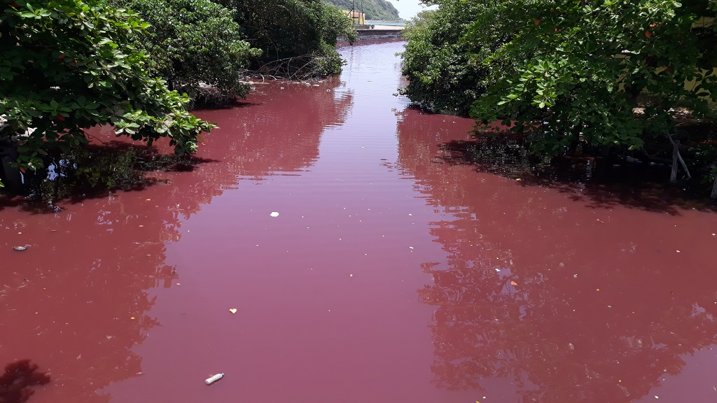
Red Blood River
Unrealistic Settings
This story talks about many unrealistic objects or things which doesn’t exist in the real world such as: metal bird, flying reptile, red sand, green lake and the crystal entity.
Red Blood River
It is a small stream whose strangely red water flow into the pacific. The water of that river has the power of absorbing radium emissions.
Notes:
This story talks about many unrealistic objects environment which doesn’t take in the real world such as: metal bird, river of blood, flying reptile, red sand, green lake and the crystal entity.

Slide 32
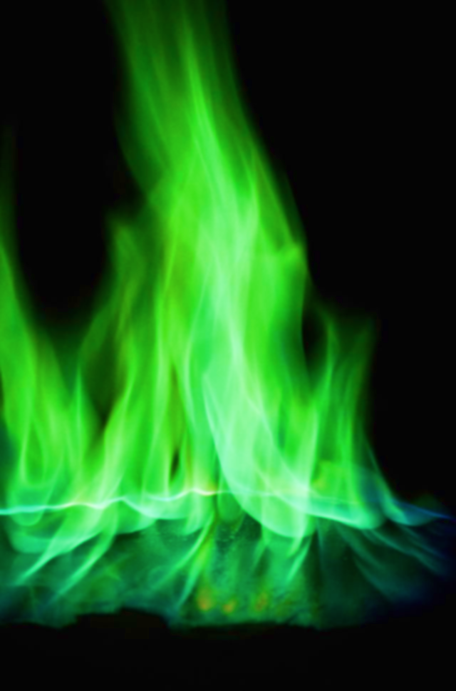
Unrealistic Settings
This story talks about many unrealistic objects or things which doesn’t take in the real world such as: metal bird, flying reptile, red sand, green lake and the crystal entity.
Red Blood River
It is a small stream whose strangely red water flow into the pacific. The water of that river has the power of absorbing radium emissions.
Green Lake
This lake is full of the heavy gases which look like a green fire from the sky. But at the surface of the lake there is the collection of the gases which release the green gas in the air which look like a green fire.
Notes:
This story tells about a river which has red color so that It looks like a river of blood. By absorbing the radium the color of the river transfer into red.
It is a small stream whose strangely red water flow into the pacific. The water of that river has the power of absorbing radium emissions.

Slide 33
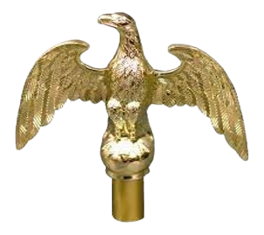
Red Blood River
It is a small stream whose strangely red water flow into the pacific. The water of that river has the power of absorbing radium emissions.
Green Lake
This lake is full of the heavy gases which look like a green fire from the sky. But at the surface of the lake there is the collection of the gases which release the green gas in the air which look like a green fire.
Metal Bird
The body of an eagle is converted into the metal. The color was white, tinged with green. At first the bird is look like made by metal but the feather was complete and flexible. Due to radium the bird converted into metal.
Notes:
This lake is full of the heavy gases which look like a green fire from the sky. But at the surface of the lake there is the collection of the gases which release the green gas in the air which look like a green fire.

Slide 34
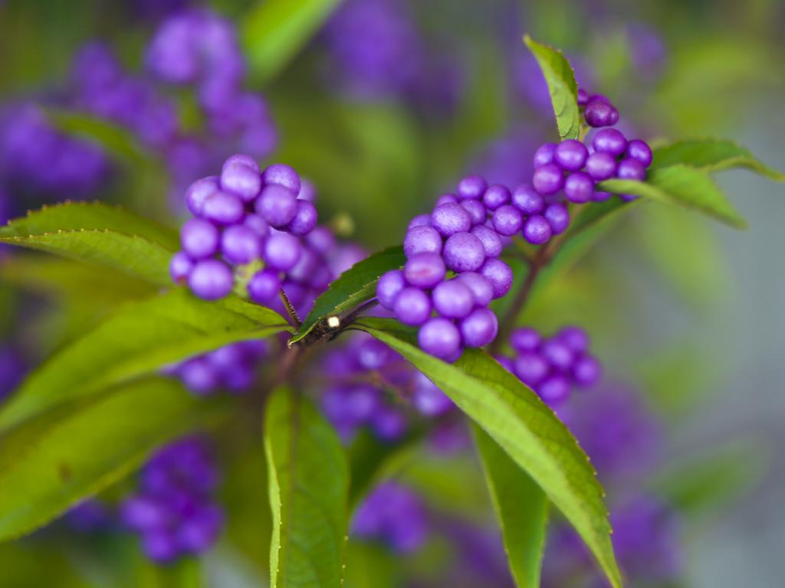
Green Lake
This lake is full of the heavy gases which look like a green fire from the sky. But at the surface of the lake there is the collection of the gases which release the green gas in the air which look like a green fire.
Metal Bird
The body of an eagle is converted into the metal. The color was white, tinged with green. At first the bird is look like made by metal but the feather was complete and flexible. Due to radium the bird converted into metal.
Purple Berries
The plant of that berries has thick narrow leaves, dotted with clusters of small pink blooms. They had a salty, metallic taste. The plants were able to exist there only because they had been so developed that they produced compounds counteracting the metal -forming.
Notes:
Not only one eagle there are many other birds which was converted into metal and half-buried in the glowing sands.
The body of an eagle is converted into the metal. The color was white, tinged with green. At first the bird is look like made by metal but the feather was complete and flexible. Due to radium the bird converted into metal.

Slide 35
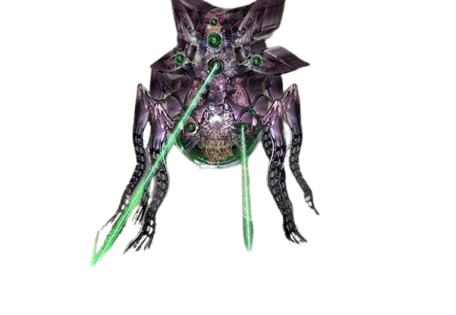
Metal Bird
The body of an eagle is converted into the metal. The color was white, tinged with green. At first the bird is look like made by metal but the feather was complete and flexible. Due to radium the bird converted into metal.
Purple Berries
The plant of that berries has thick narrow leaves, dotted with clusters of small pink blooms. They had a salty, metallic taste. The plants were able to exist there only because they had been so developed that they produced compounds counteracting the metal -forming.
Crystal Entity
Story talks about an entity which don’t look familiar to human and so it is referred as an Alien. The entity which has a great-six-sided, upright prism of red, a dozen feet in length, it was six-pointed structure like a snowflake
Notes:
The plant of that berries has thick narrow leaves, dotted with clusters of small pink blooms. They had a salty, metallic taste. The plants were able to exist there only because they had been so developed that they produced compounds counteracting the metal -forming.
.
The juice of the berries has ability to fight against the metal-forming.

Slide 36
Purple Berries
The plant of that berries has thick narrow leaves, dotted with clusters of small pink blooms. They had a salty, metallic taste. The plants were able to exist there only because they had been so developed that they produced compounds counteracting the metal -forming.
Crystal Entity
Story talks about an entity which don’t look familiar to human and so it is referred as an Alien. The entity which has a great-six-sided, upright prism of red, a dozen feet in length, it was six-pointed structure like a snowflake
Notes:
Story talks about an entity which don’t look familiar to human and so it is referred as an Alien. The entity which has a great-six-sided, upright prism of red, a dozen feet in length, it was six-pointed structure like a snowflake
They have a purple cone which must been an eye. They sleep at the day time.

Slide 37


